Slide 1
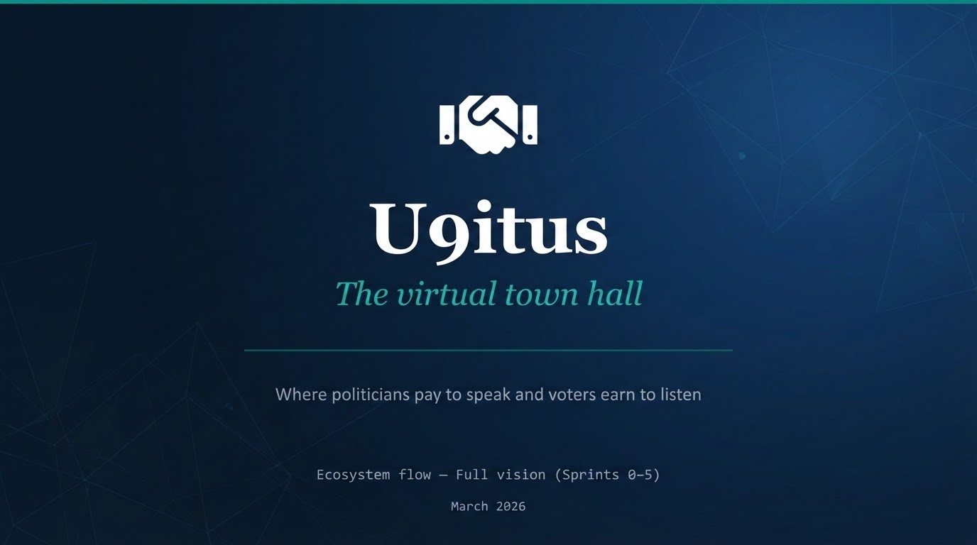

Slide 2
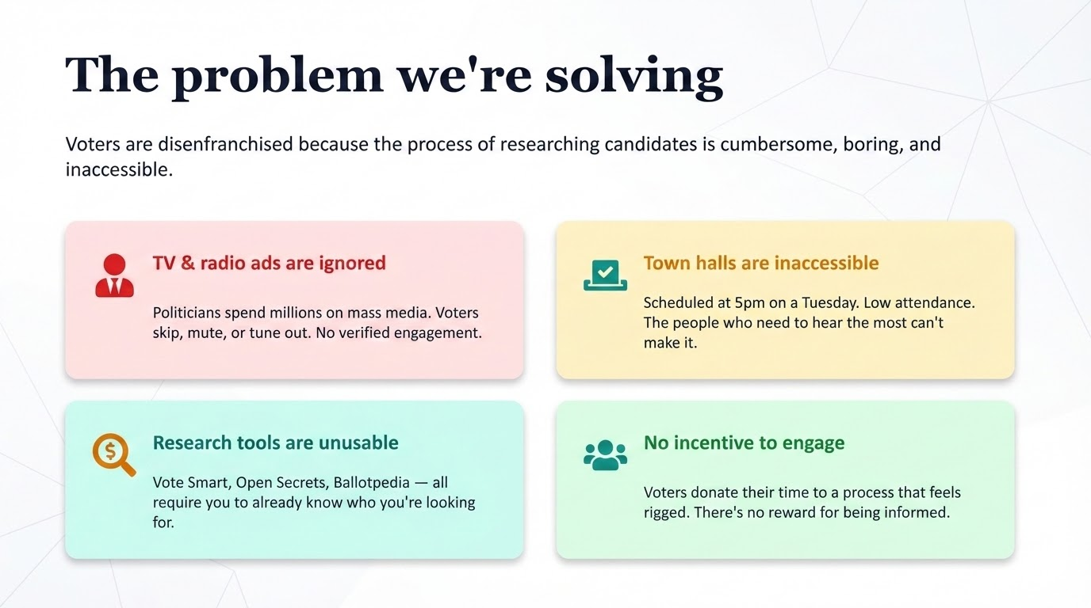

Slide 3
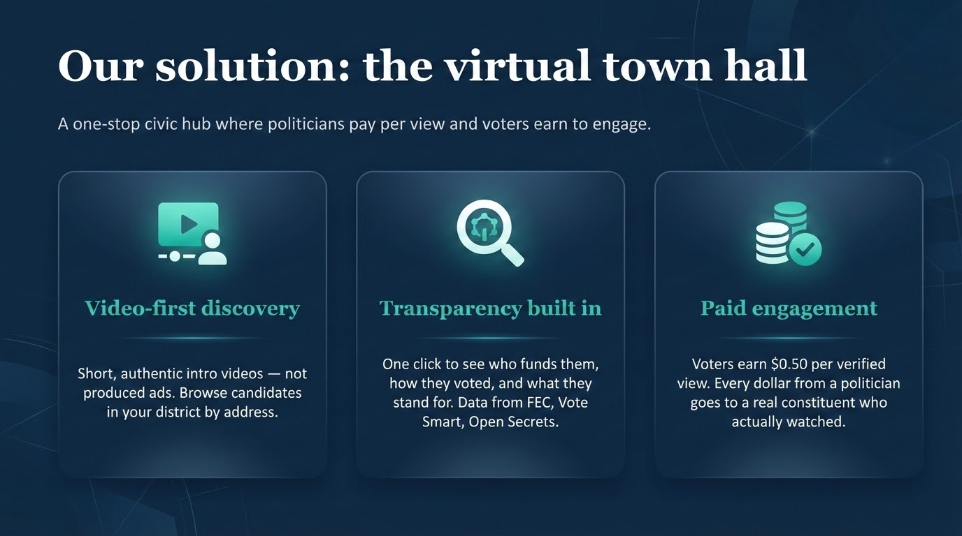

Slide 4
PHASE 1
Get on the platform
Politician journey
Voter journey
P1
Create account
LIVE
V1
Enter address
NEW
Name, office, governance level, district. Pending admin approval.
Type your address. Instantly see your district and every candidate running in it.
P2
Load credits via Stripe
LIVE
V2
Browse candidates
NEW
Top up balance. Post-fee amount shown transparently. Held in escrow until views occur.
See all politicians in your district — no login required. Photos, office, party, district.

Slide 5
PHASE 2
The town hall
Politician
Voter
P3
Upload intro video
LIVE
V3
Sign up to earn
LIVE
30s max. Real, authentic. "Hi, I'm running for X because Y." This is the handshake.
Email + ZIP. Now you can watch and earn. You already know what's here from browsing.
P4
Answer Q&A videos
NEW
V4
Watch intro → earn $0.50
LIVE
Pre-set questions voters care about: guns, education, housing. Each is a separate paid view.
Watch 10+ seconds. $0.50 instantly credited. One-to-one — every view counts.
P5
Target district
LIVE
V5
Watch Q&A → earn more
NEW
Geographic targeting by ZIP and governance level. Videos only shown to voters who can vote for you.
Browse by topic in your district. Watch answers, earn per view. This is the town hall.

Slide 6
How money moves
Per verified view — simultaneous debit and credit
$1.00
$0.50
$0.50
→
+
Politician pays
Voter earns
Platform keeps
No impressions. No CPM. Every dollar goes to a real person who actually watched. Verified by 10-second heartbeat, one-time secure token, 24-hour expiry.

Slide 7




PHASE 3
Dig deeper — transparency layer
What makes U9itus different from every other political platform: voters can verify what politicians claim.
FEC
Vote Smart
Campaign finance — donations received, money spent, donor lists
Voting history, issue positions, interest group ratings
Open Secrets
Ballotpedia
Donor and lobbyist information — who's really funding this candidate
Electoral history, biographical data, past races and results
"He can't dance. He's got to come clean." — John Head, March 11

Slide 8
PHASE 4
Grow the ecosystem
Politician growth loop
Voter growth loop
P8
Get real feedback
V8
Take surveys → earn
See survey results from your district. What do voters actually care about?
"What frustrates you about voting?" Compensated micro-surveys.
V9
Refer friends → earn
P9
Create more content
10% commission on every view your referrals complete.
Answer more questions. The more you engage, the more voters see you.
V10
Cash out at $5
Request payout via PayPal or CashApp. Real money for being informed.

Slide 9




Why this works
For voters
For politicians
One place to learn everything real about your candidates — who funds them, what they stand for — and get paid to engage.
Every dollar goes to a real constituent who actually watched your message. No wasted impressions. Direct, verified engagement.
The problem it solves
What makes it different
Researching candidates is cumbersome, boring, and inaccessible. Nobody does it. TV ads are ignored. Town halls are at 5pm on a Tuesday.
No other platform combines video-first introductions, public accountability data, paid engagement, and district-level targeting in one place.

Slide 10

Unite the politician and the voter.
U9itus — The Virtual Town Hall
Head Enterprises · JEldon LLC · HeadisHere
un9itus.com

